Slide 1
Photo Blog

Slide 2
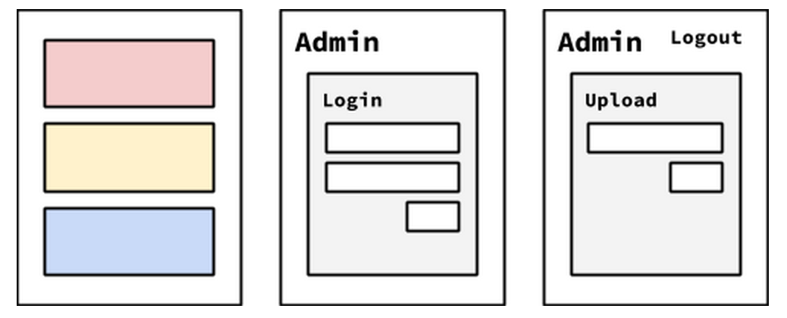
Photo Blog
Our goal for this project is to create a basic photo blog. It should have a few pages:
The initial page (https://localhost:8080/) should list the most recent uploaded photos.
Clicking a photo should download it. (hint: HTML5 download attribute or the Content-Disposition header)
There should be an admin page (https://localhost:8080/admin) which allows a user to login (you can hardcode the username and password).
Once logged in the admin user should be presented with a form to upload an image.
The uploaded image should then be accessible on the main page.
The admin section should require TLS.
A self-signed certificate is ok. It’s ok to require TLS for the regular section of the site as well.

Slide 3
one version

Slide 4
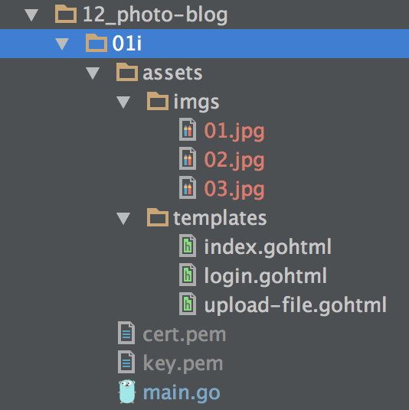

Slide 5
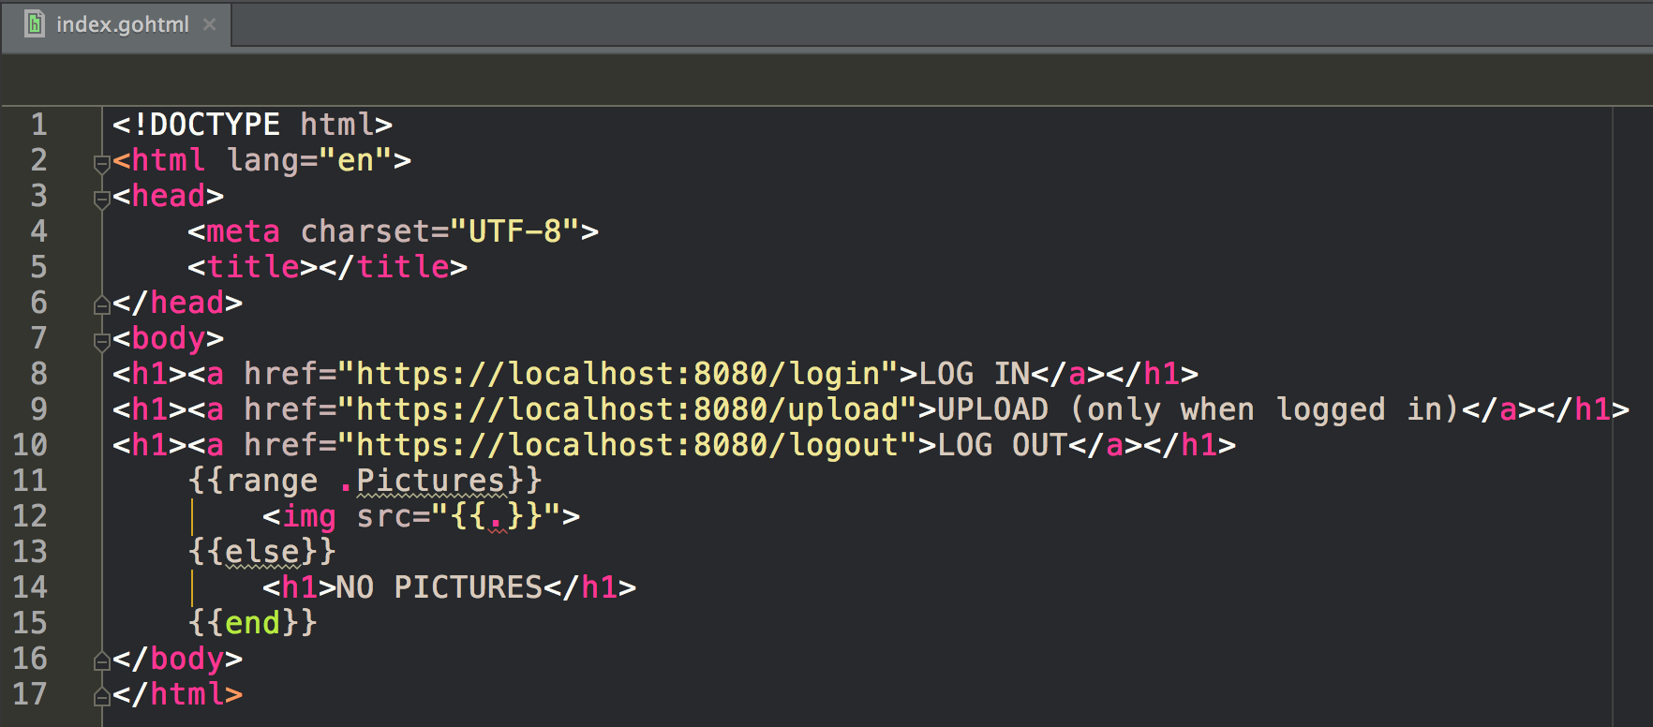

Slide 6
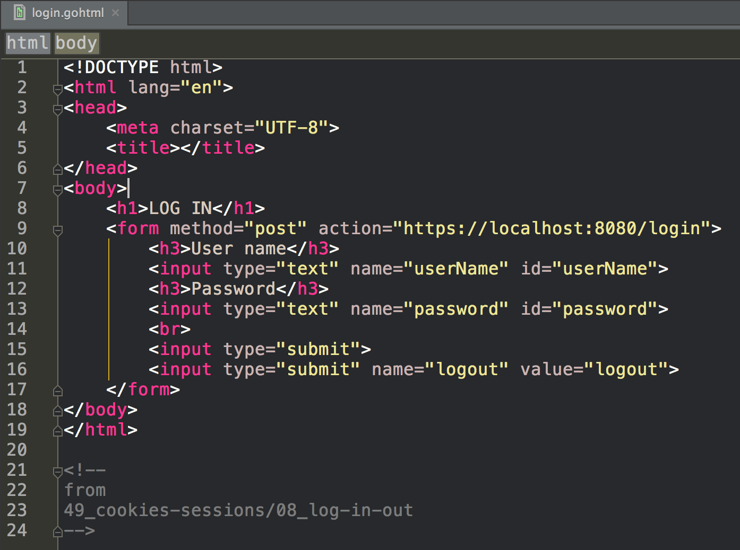

Slide 7
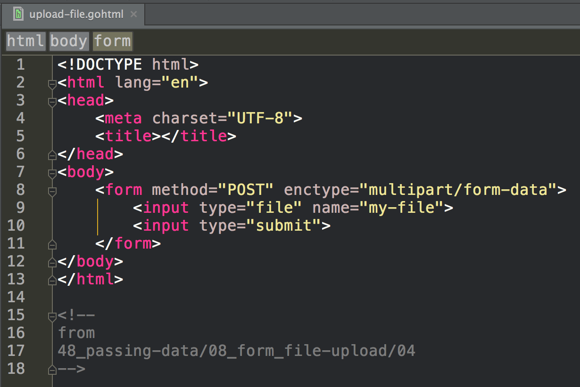

Slide 8
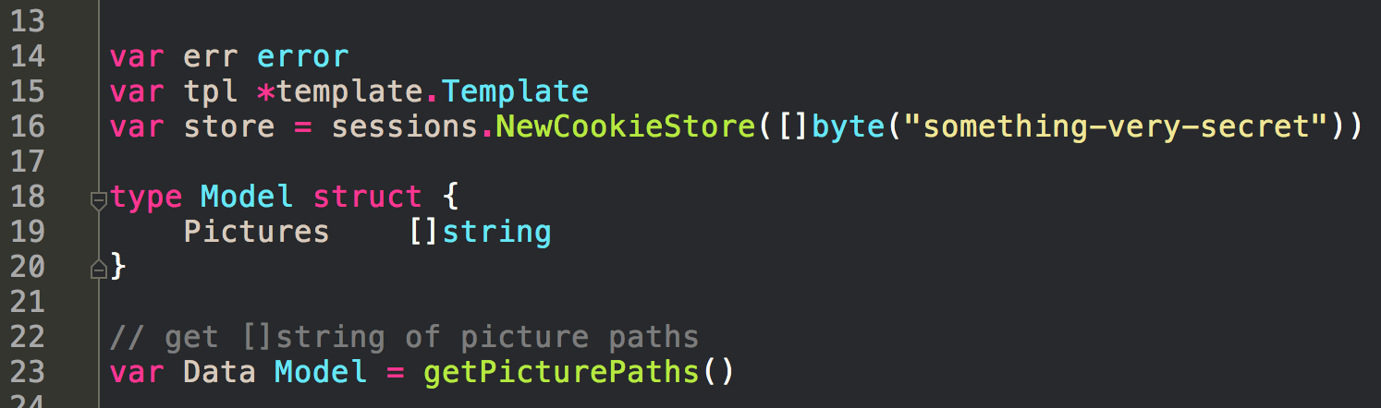

Slide 9
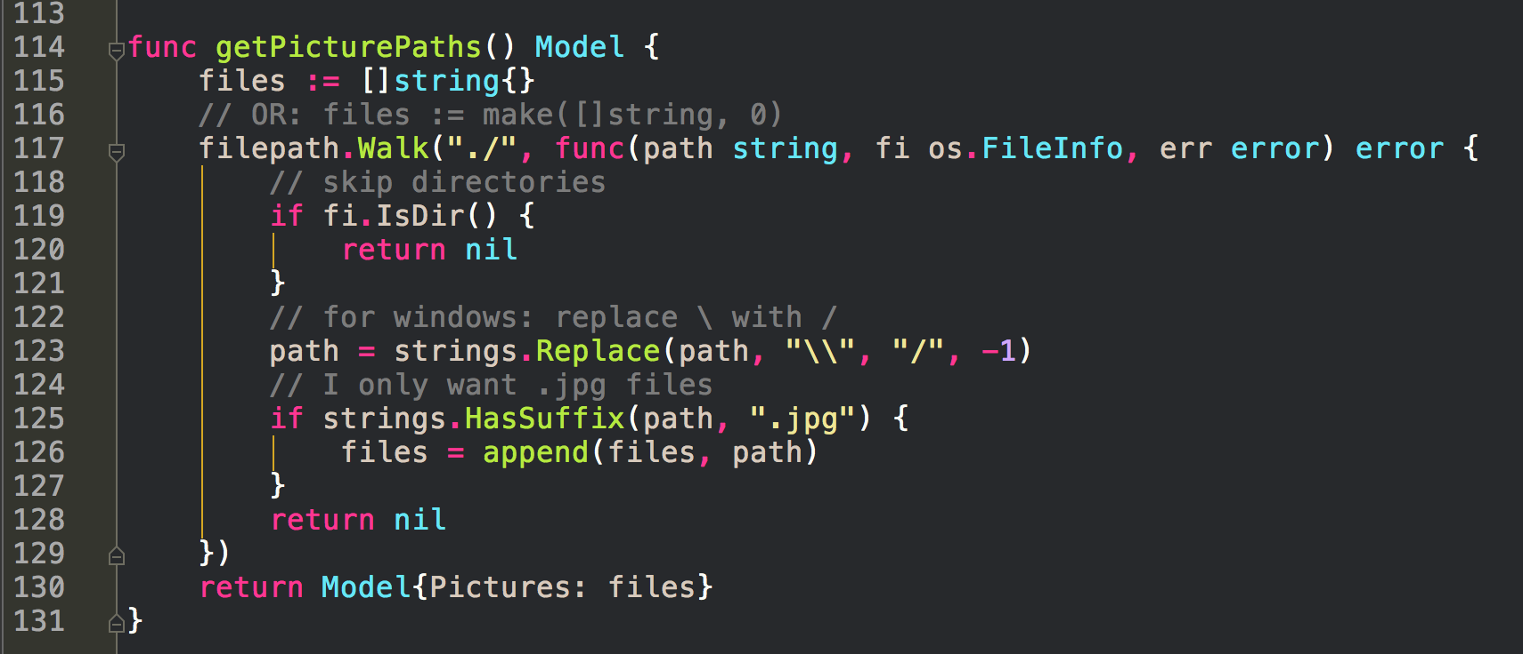

Slide 10
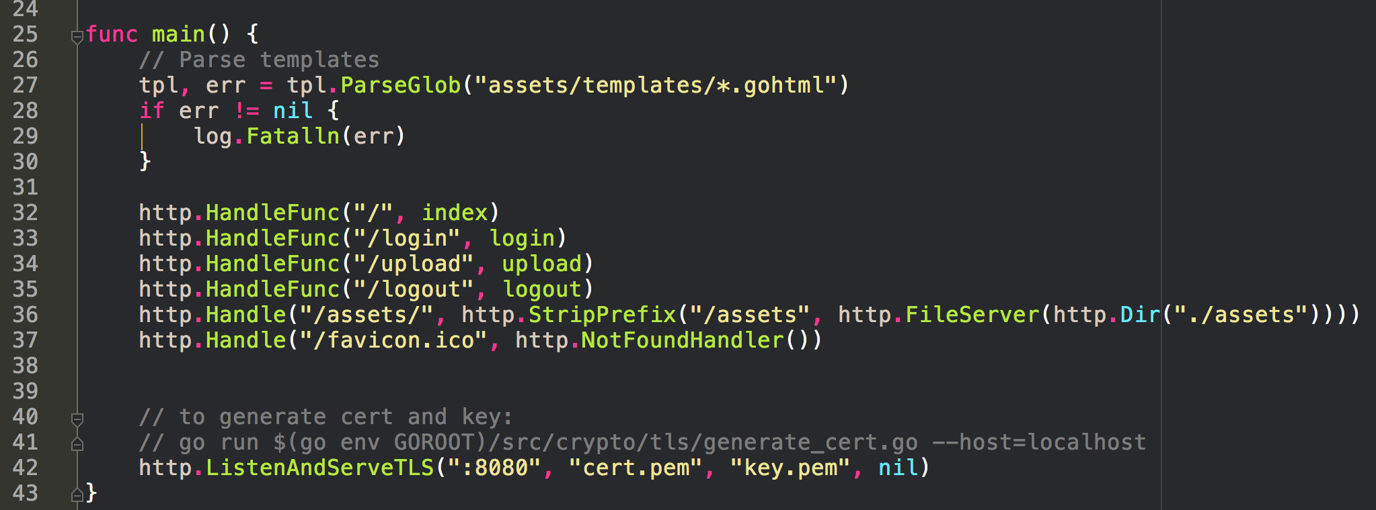

Slide 11
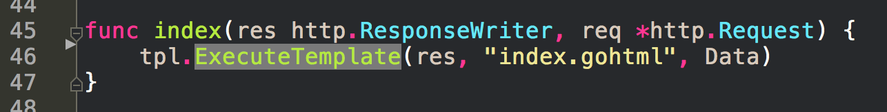

Slide 12
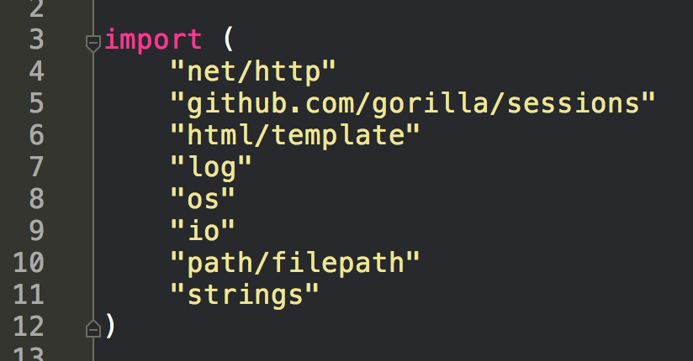

Slide 13
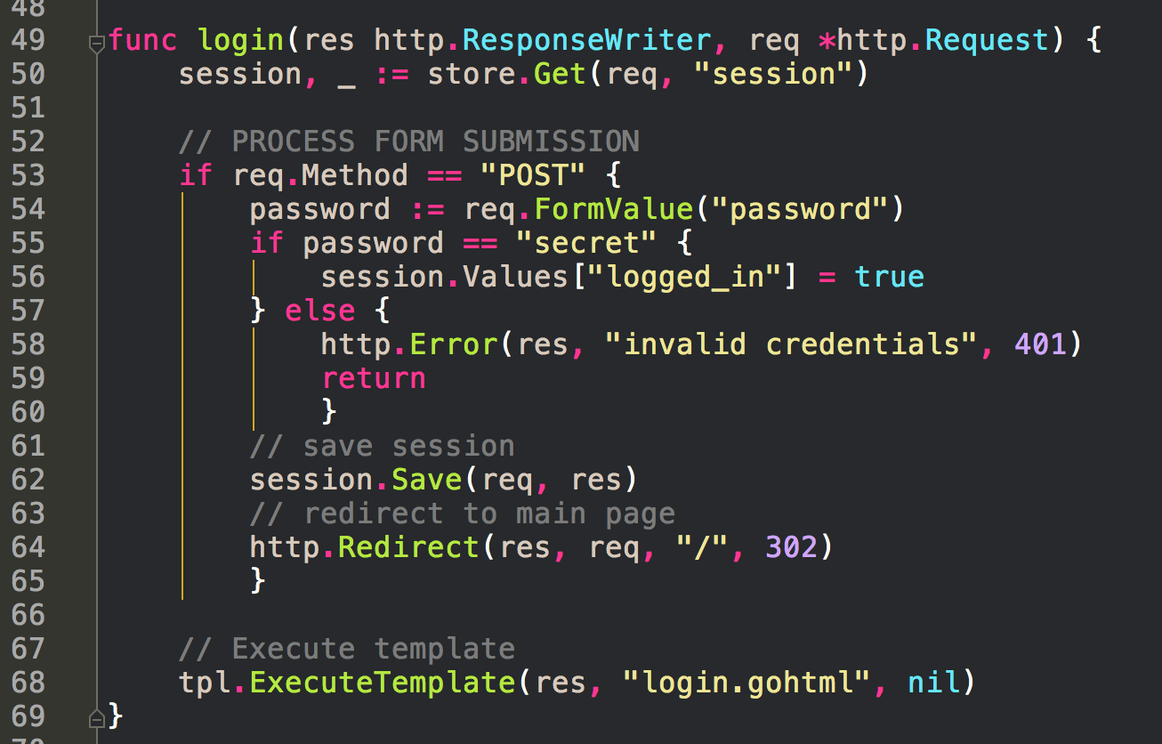

Slide 14
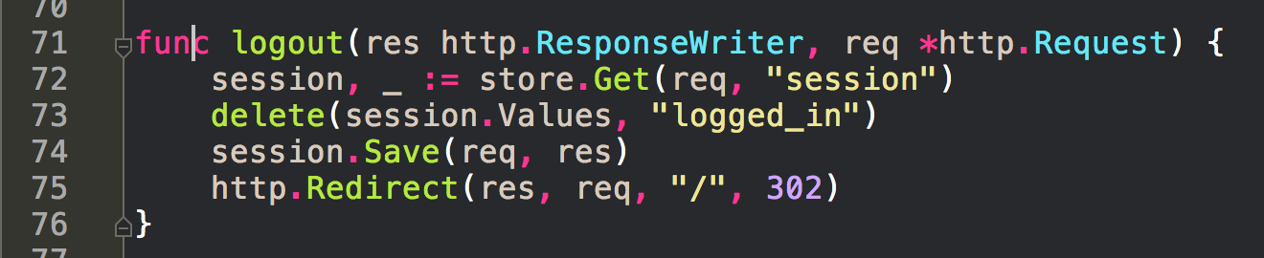

Slide 15
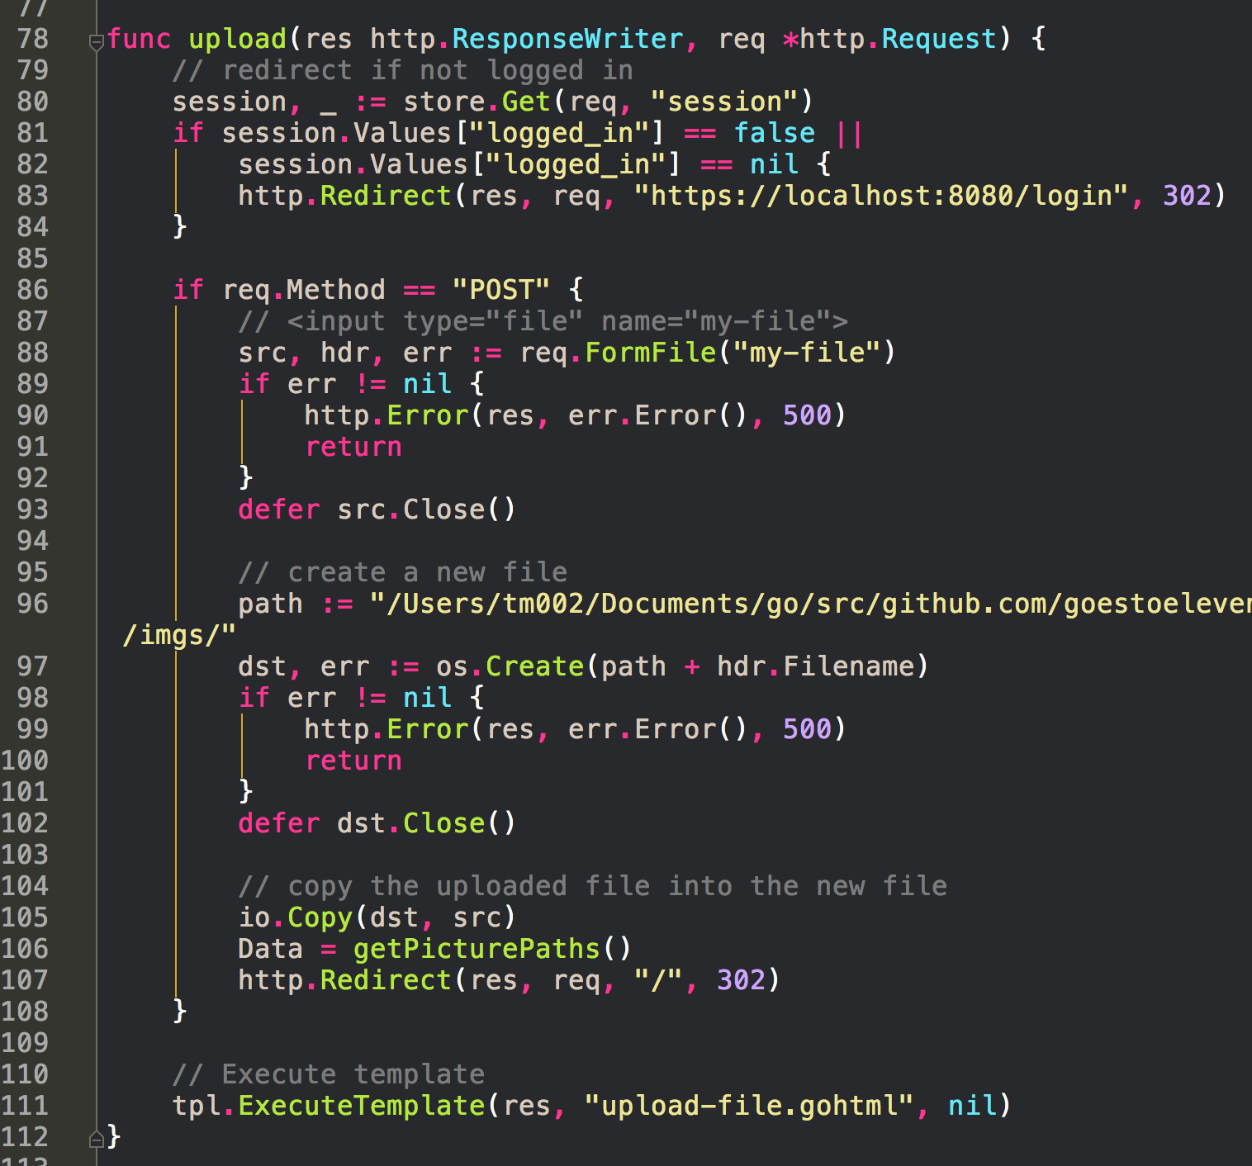

Slide 16
another version

Slide 17
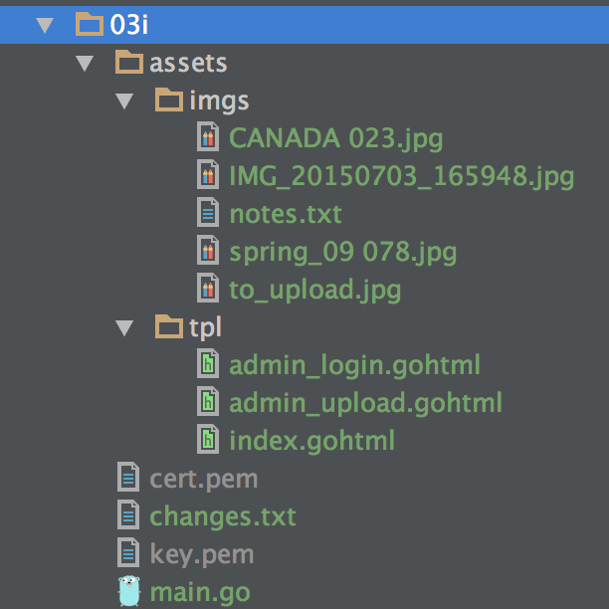

Slide 18
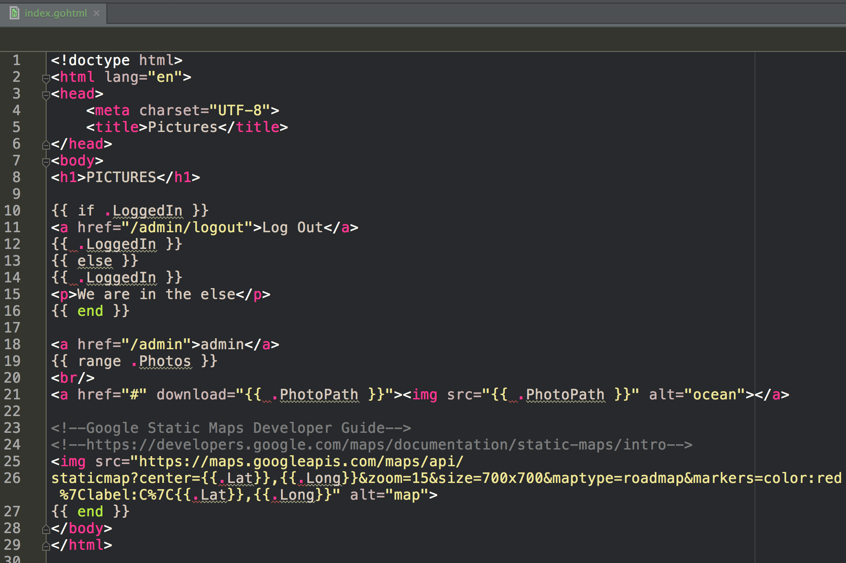

Slide 19
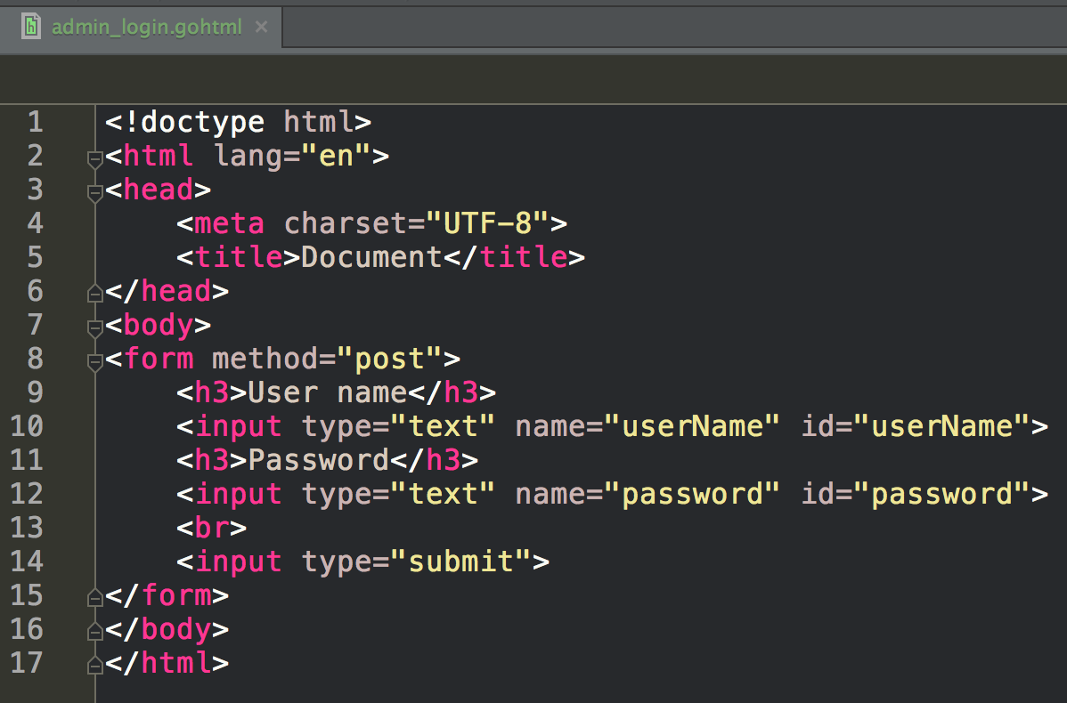

Slide 20
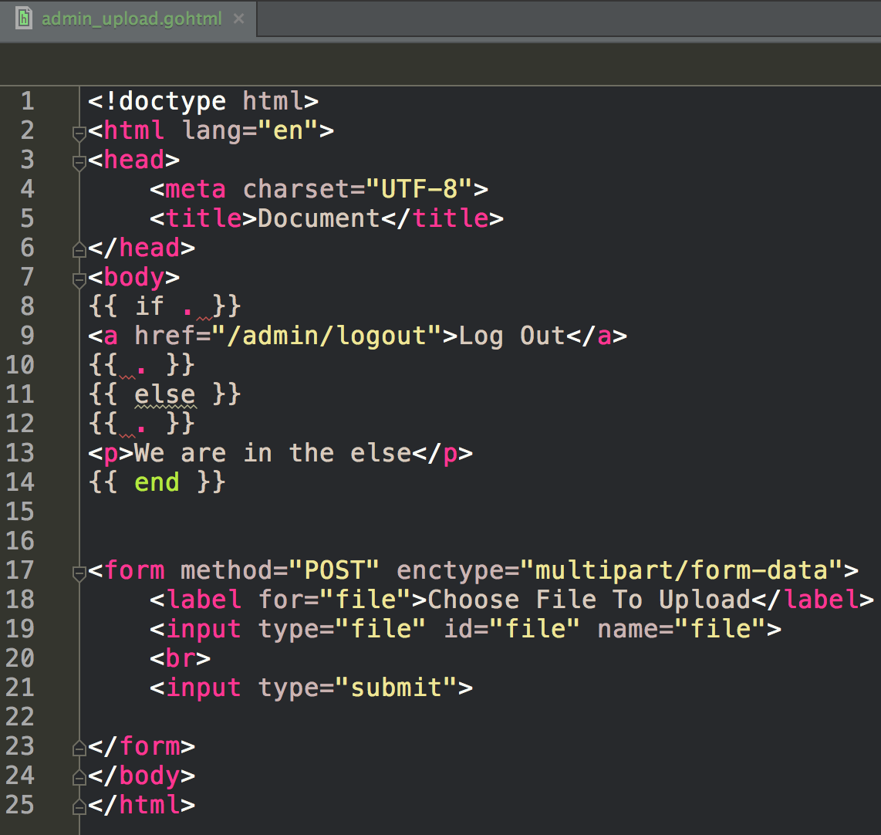

Slide 21
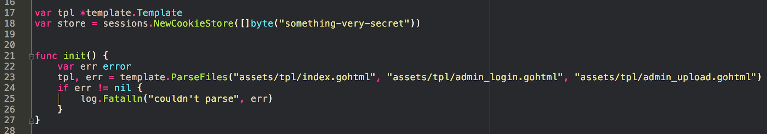

Slide 22
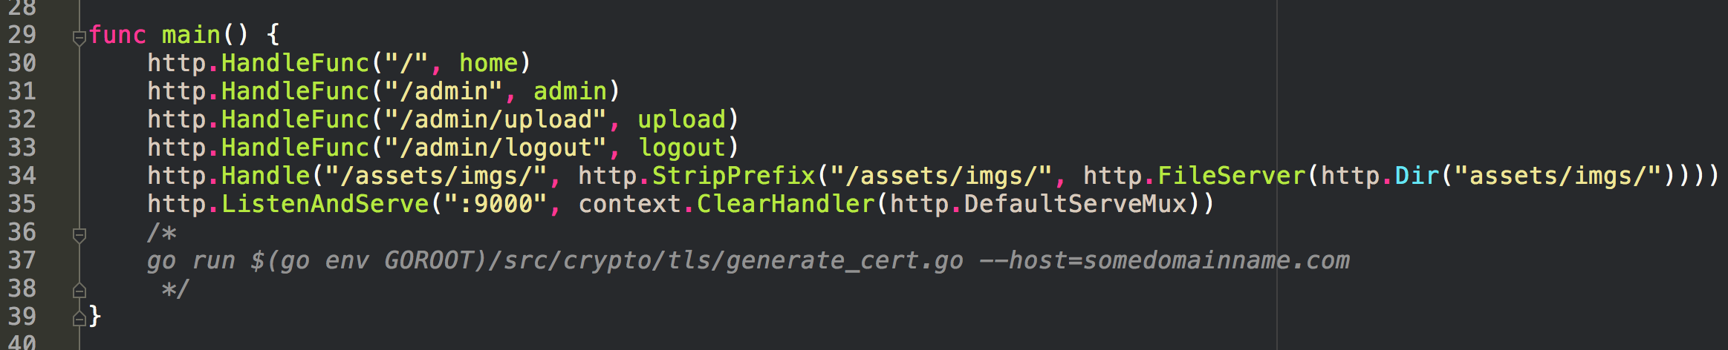

Slide 23
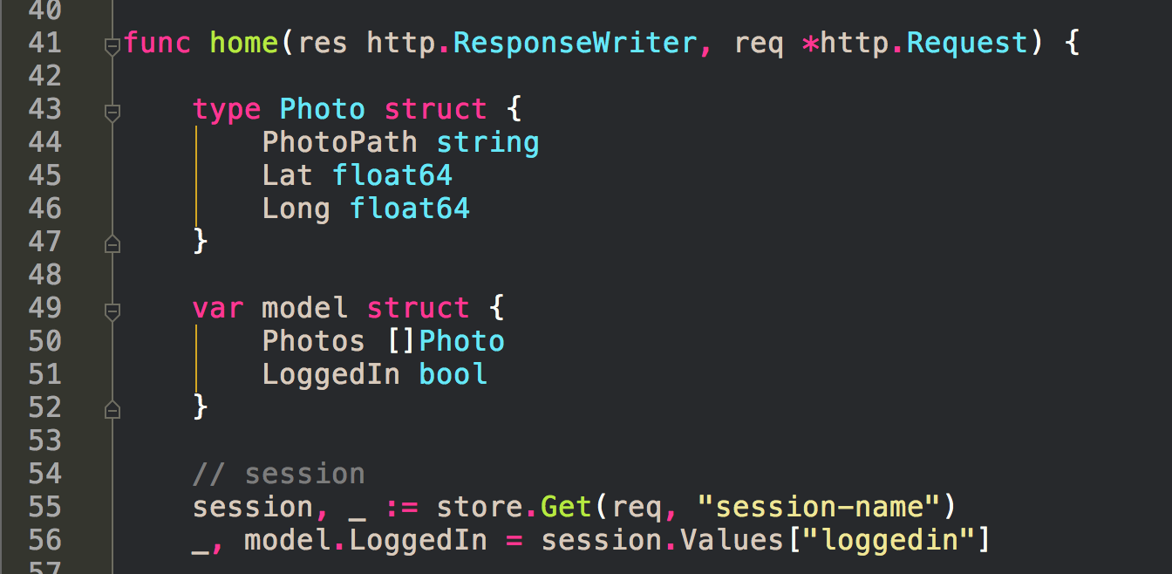

Slide 24
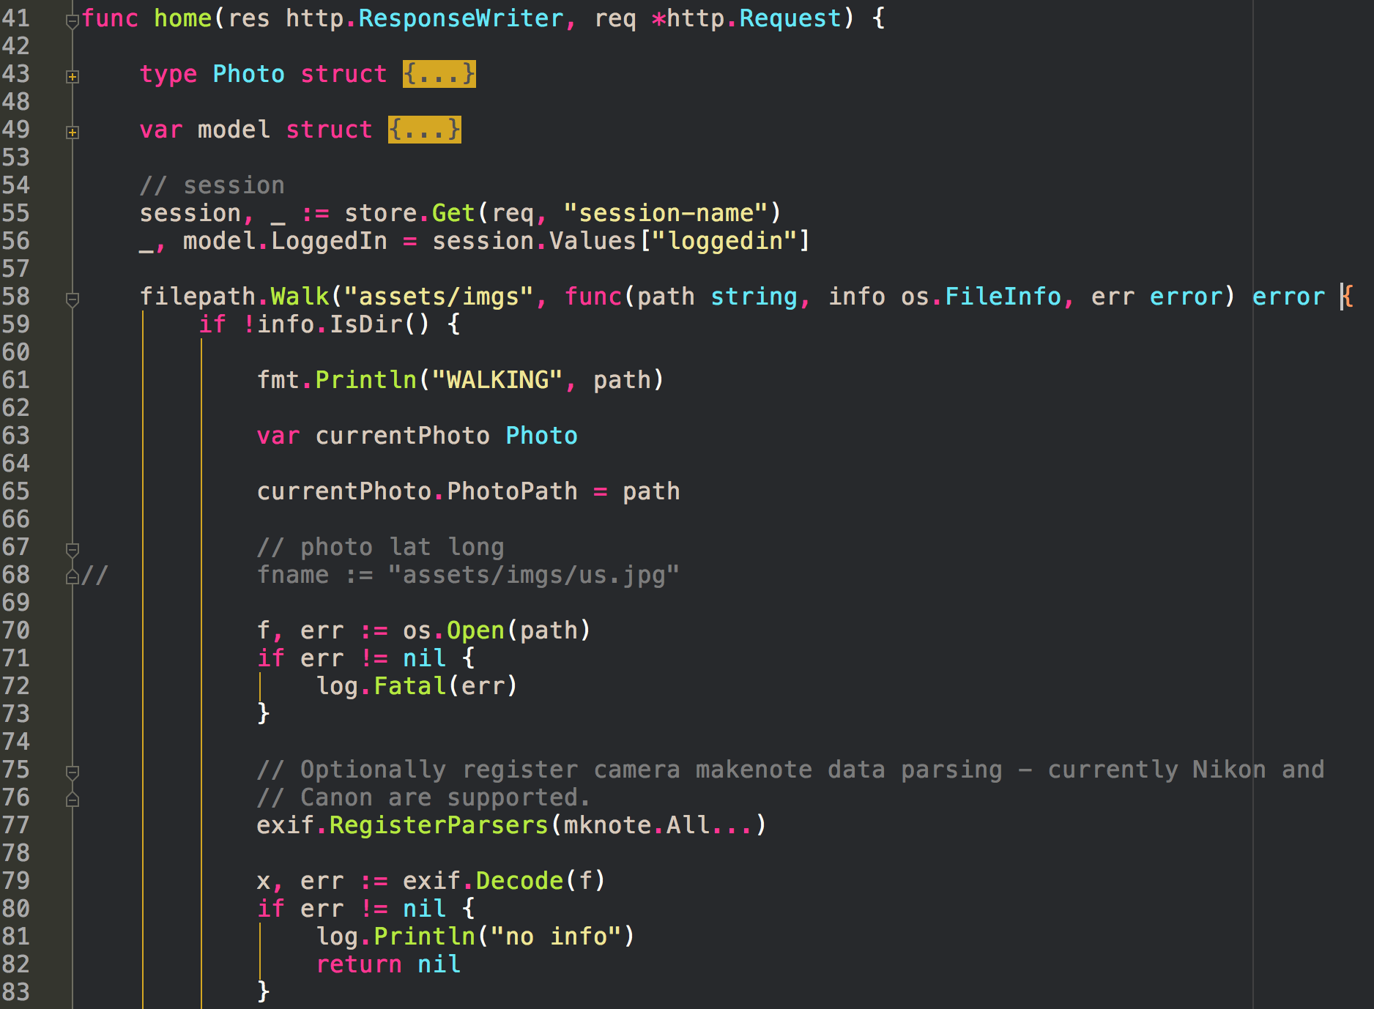

Slide 25
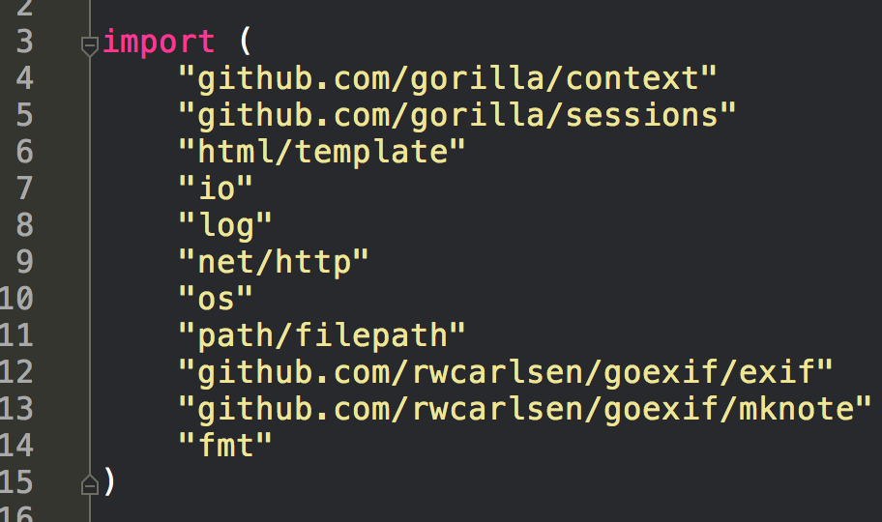

Slide 26
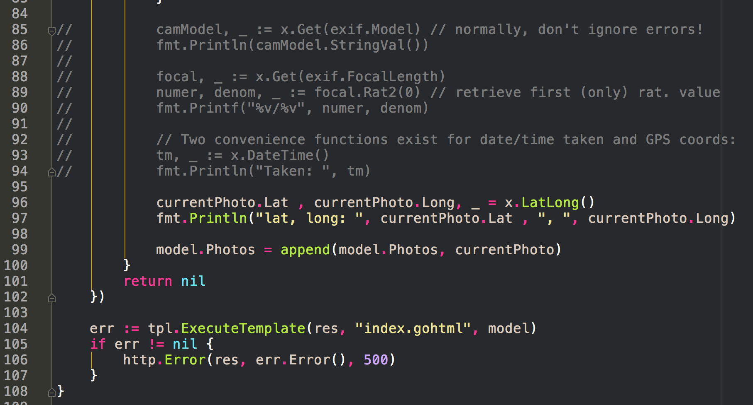
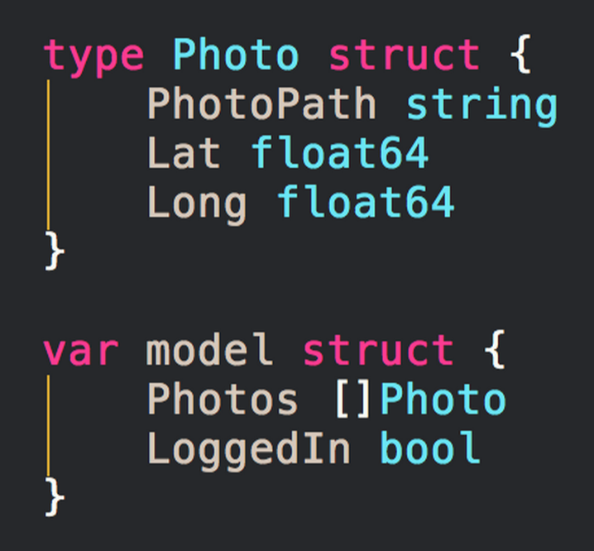

Slide 27
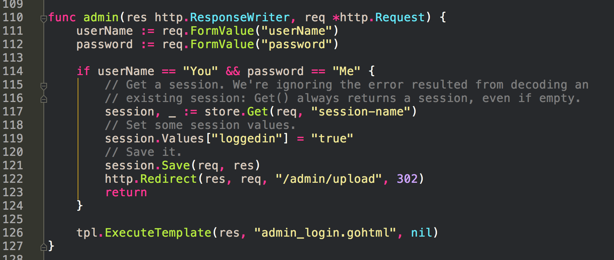

Slide 28
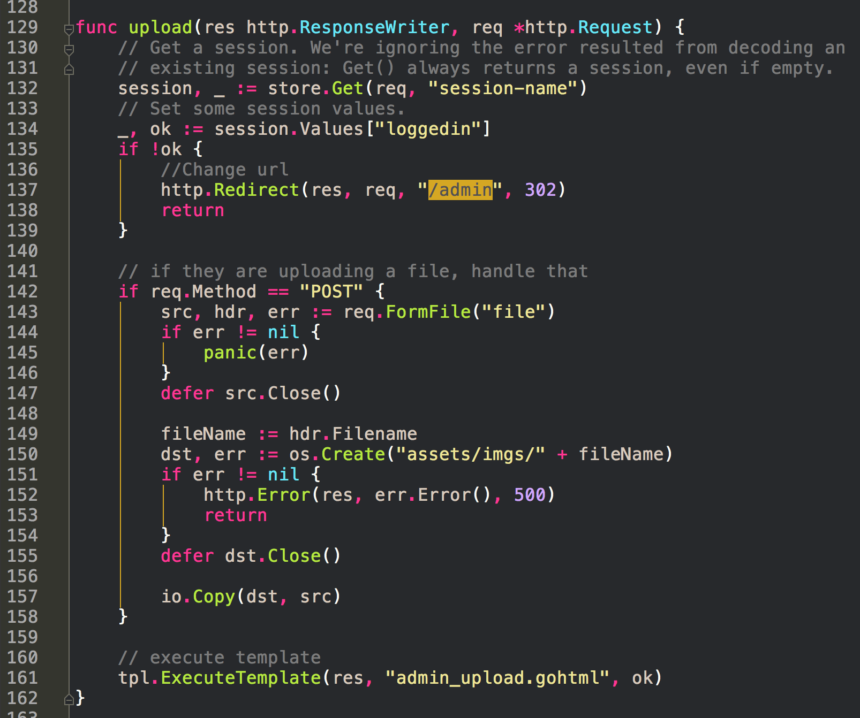

Slide 29
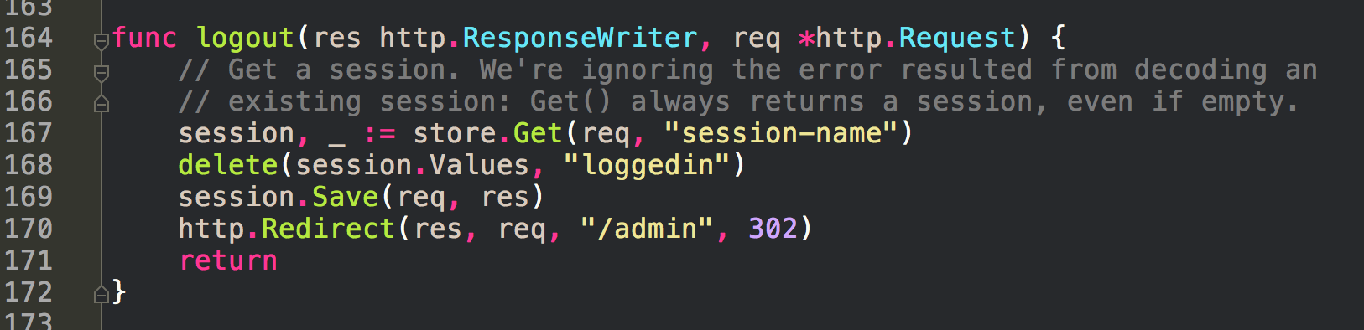

Slide 30
“This is not a small deal that you’re able to make this. Very few people in the world are able to build a web app like this. It requires a lot of specialized knowledge.”
~ Caleb Doxsey

